Slide 1
STOCK MARKET ANALYSIS USING HADOOP
1
MADE BY-
Sneh Rathore :02913303114

Slide 2
2
Introduction
Stock market data of various companies is analyzed with the help of shell scripts that run on Hadoop cluster which tells us about the company’s current position in the market and various other factors.
The process of analyzing is made automated with the help of shell scripts in which analyzing queries are pre-written.
This project aims at providing simple and easy analysis of various Stocks as per the user's requirement.
Notes:
2

Slide 3
Objective
3
This project is based on Big Data analysis of Stock Market. The daily commodity rates of various company shares are collected and are analyzed with the help of query method.
One can easily have a market watch for any day he/she wants to look at falling in the year 2016. The user can find out his profit/loss for the share he/she owns with the help of current price rate of that share stored in our database.
One can also compare different shares' highs and lows with respect to the market position. This project aims at providing simple and easy analysis of the Stock Market as per the user's requirement.
The analysis result can be obtained in the form of tables, graphs and pie charts. The user gets a choice to choose the method of his analysis based on the script he selects. Relational structured data has been taken in order to complete this analysis task.

Slide 4
Technical Background
4
The Big Data Hadoop technology run on linux platform Ubuntu is used to build up the project. The Stock Market data is stored in the HDFS which is further accessed, analyzed and processed with the help of HIVE, SQOOP and MYSQL commands.
Various packages are installed in the Hadoop cluster setup in order to perform specific tasks. The data stored in the HDFS is fetched according to the clients’ demands.
Queries are pre-written into the shell scripts which make analyzing fully automated.
R-base is used to analyze data on the bases of graphs and pie charts which are stored in the form of image which can be accessed anytime.

Slide 5
How Analysis is done
5
Stock market data is saved as .csv file which is comma separated file, which is then uploaded to hdfs.
Then it is exported to Sql tables using Sqoop package.
Data is also loaded into hive using hive commands, mappers, etc.
Analyzing queries are then applied on this data which finally gives us information.

Slide 6
Strategy
6
The strategy of our project is to give user real time analysis of any company’s stock that whether he/she should buy the shares or not.
Analysis is divided into two parts:
Technical
Fundamental
Technical analysis shows the result for future possible trends.
Fundamental analysis shows result on the bases of their performance till now.

Slide 7
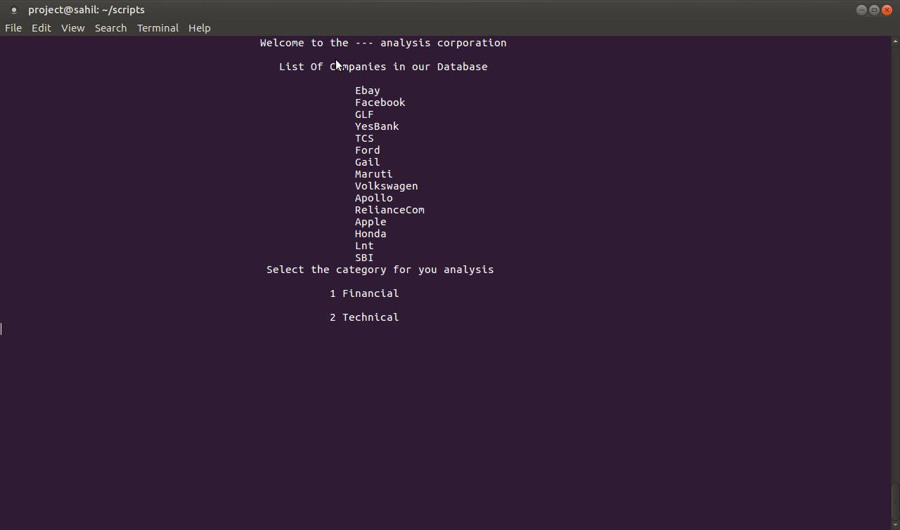
Overview to the Analysis
7

Slide 8
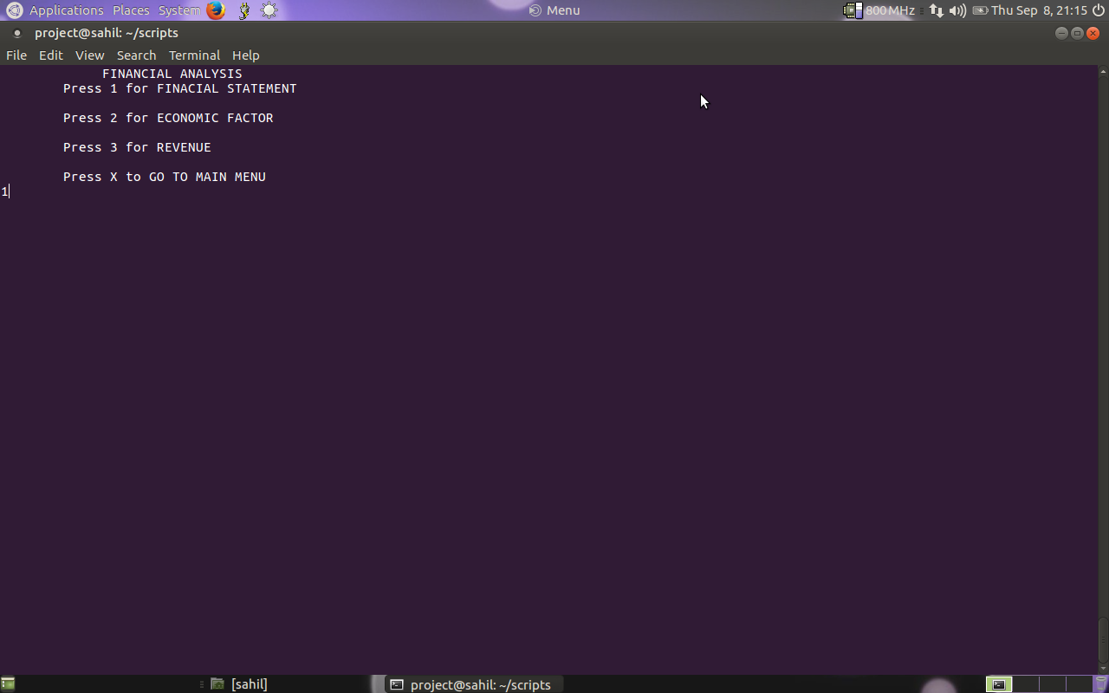
Financial Analysis
8

Slide 9
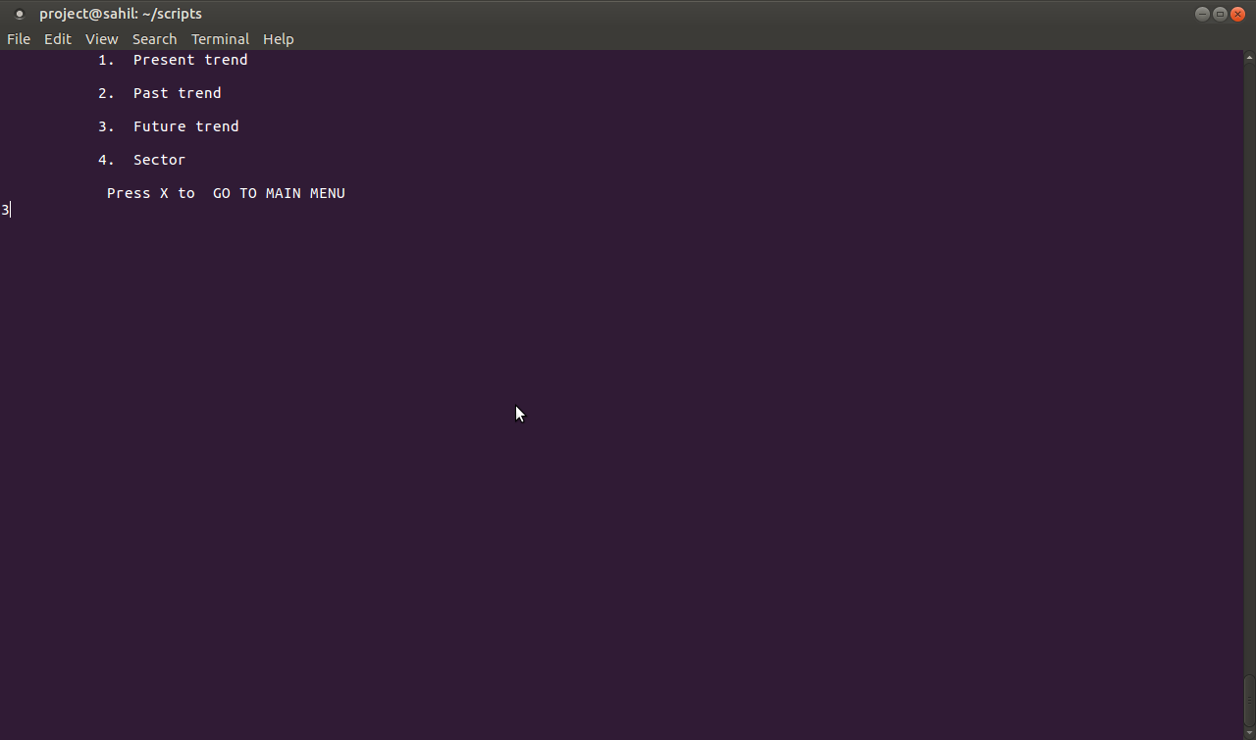
Technical Analysis
9

Slide 10
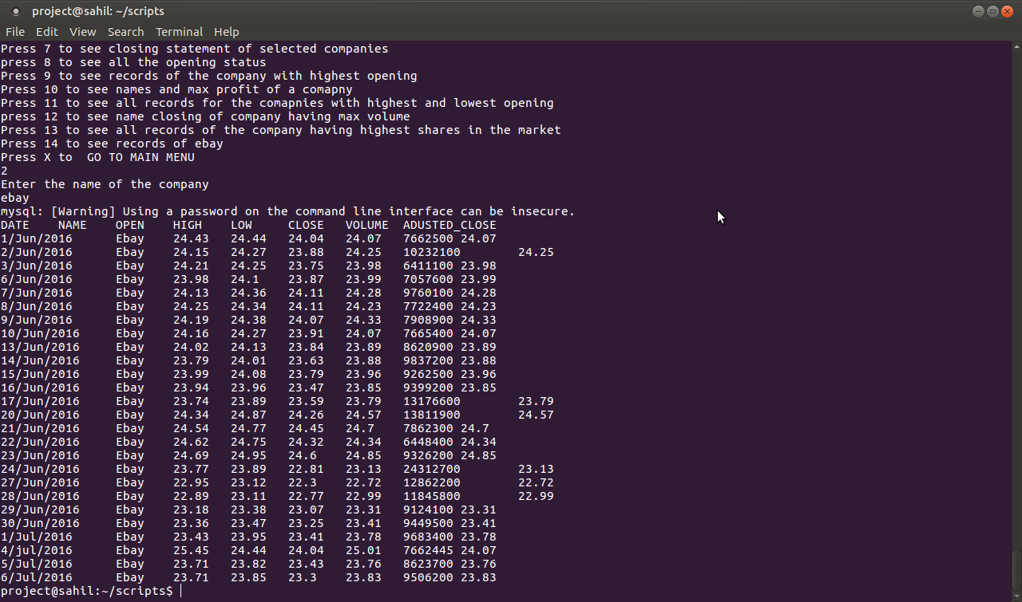
Query Execution
10

Slide 11
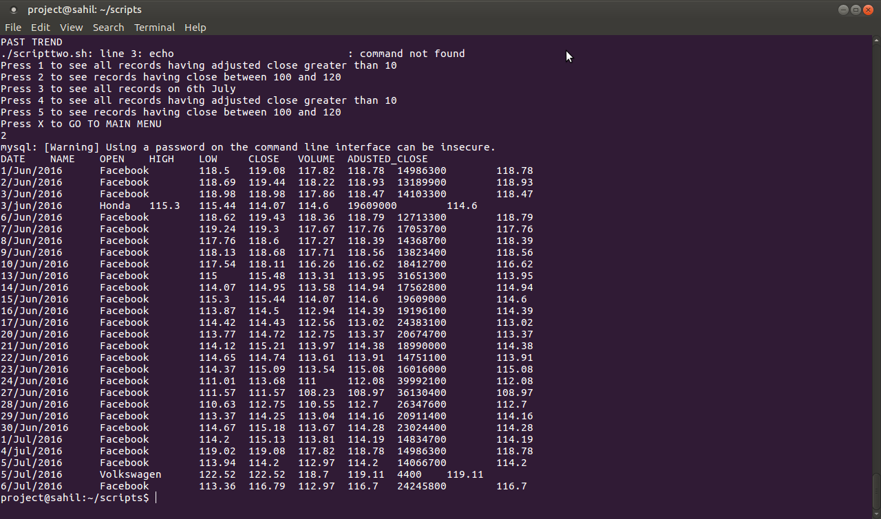
Query Execution
11

Slide 12
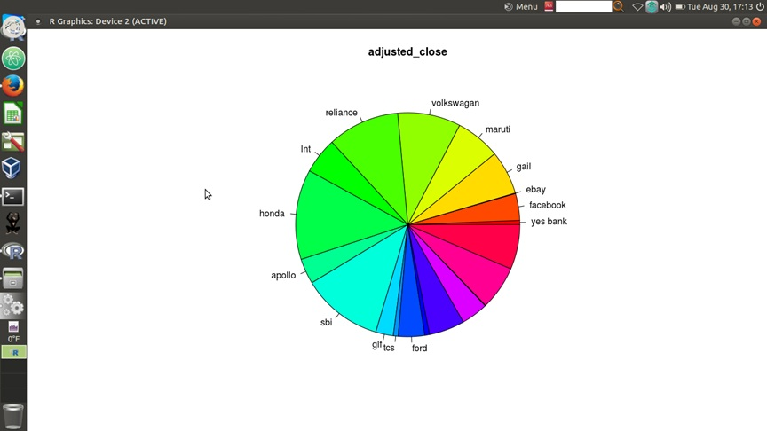
Analysis through Graph-Example
12

Slide 13
Our Strengths
13
We have a team of 5 members , each of us are specialized in different domains. As a team we stand strong in front of any problem that we come across while completing the project.
Each individual is learning something different and have come up with great ideas and solutions.

Slide 14
CONCLUSION
14
STOCK MARKET ANALYSIS is a real-life based application where a user can fetch the data for all those companies pre-listed in the project (under the main_script). Here, we use MySql , sqoop which are executed through the various scripts in order to perform the analysis. This project has a user-friendly interface and covers all the aspects of an analysis.

Slide 15
15
THANK YOU

